Slide 1
Unit-3 Agile Development Software Engineering

Slide 2
Agility
What is Agile?
Agile refers to something that is quick or adaptable. A software development approach based on iterative development is referred to as an “agile process model.” Agile approaches divide projects into smaller iterations or sections and avoid long-term planning. The scope and requirements of the project are defined at the start of the development phase. The number of iterations, duration, and scope of each iteration are all clearly determined ahead of time.

Slide 3
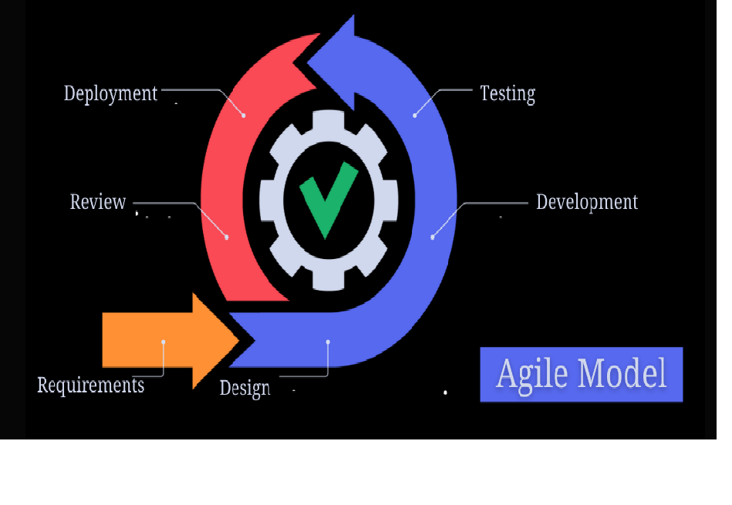
Agile Process

Slide 4
Phases of an agile process model
1) Requirements gathering
In this phase, requirements should be characterized. Different business opportunities are explained and for the building of the project efforts and time are planned.
2) Design the requirements
At the point when you have distinguished the task, work with partners to define the requirements. You can utilize the client stream graph to show crafted new elements and show how they will apply to your current framework.
3) Construction/ iteration
At the point when the group characterizes the requirements, the work starts. Creators and designers begin to work at their task, which means sending a functioning item. The item will go through different phases of progress, so it incorporates easy minimal functionality.

Slide 5
Phases of an agile process model
4) Testing
In this stage, the Quality Assurance group analyzes the item’s presentation and searches for the bug.
5) Deployment
In this stage, the group gives an item for the client’s workplace.
6) Feedback
When a product is released, feedback is the last step. Feedback is received regarding the product and manages the input.

Slide 6
When to use an agile model?
To execute a new feature, the developers need to lose just crafted by a couple of days, or even just hours, to move back and carry out it.
At the point when new changes are required to have been carried out. The freedom agile provides for change is vital. New changes can be carried out at almost no expense on account of the recurrence of new augmentations that are created.
End clients’ requirements are truly changing in a powerful business and IT world. Changes can be examined and elements can be affected. This really gives the client the completed framework they need or want.

Slide 7
Pros
Advances teamwork and broadly educating.
Usefulness can be grown quickly and illustrated.
Conveys early fractional working arrangements.
A great model for conditions that change consistently.
Asset requirements are minimum.

Slide 8
Cons:
Not appropriate for handling complex conditions.
There is an absence of emphasis on vital planning and documentation.
If the client requirement is not clear, chances are that project can easily get taken off track.
Just senior software engineers are fit for taking the sort of choices expected during the improvement cycle. So it has a bad situation for junior software engineers unless combined with experienced assets.

Slide 9
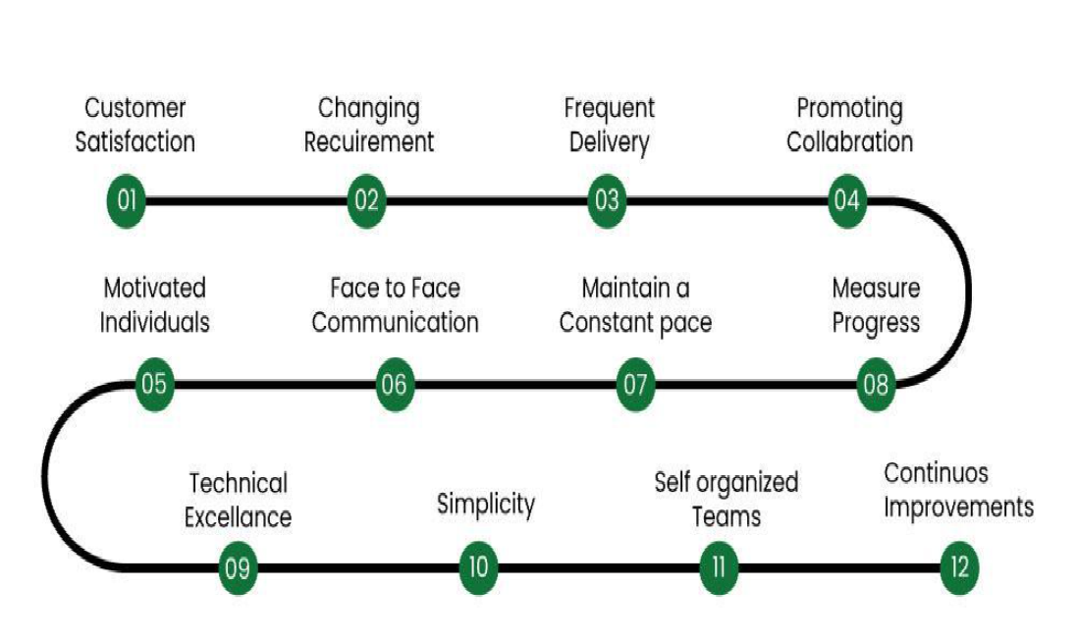
Agility Principles

Slide 10
Agility Principles
early and continuous delivery of valuable software.
Being flexible about change at any point of development.
Working on frequent and short deliveries throughout the development process.
transparency between business people and developers and requires them to work together
motivating individuals in the team.
agile believes in face to face communication as the most effective way to communicate between and to development team.

Slide 11
Agility Principle
continuous attention towards effective designing and technical excellence
promotes sustainable development.
Working software is the primary measure of progress
Simplicity—the art of maximizing the amount of work not done—is essential.
The best architectures, requirements, and designs emerge from self-organizing teams.
the team reflects on how to become more effective, then tunes and adjusts its behavior accordingly

Slide 12
Traditional SDLC Model | Agile Model
The traditional SDLC model is a linear and sequential approach to software development. | The agile model is an iterative and flexible approach to software development.
It doesn't provide a clear plan to incorporate changing requirements, which can lead to delays. | It focuses on the working software, feedback, and adapting to new requirements.
It focuses on a structured plan, not the final product's delivery. | The Agile model aims to deliver the product quickly.
It focuses on documentation, which helps track the progress and decisions made throughout the project. | The Agile model lacks documentation. It includes regular meetings, also known as sprint meetings, to track the development team's progress.
It is best suited for projects that require a structured approach and have well-defined requirements. | It is best suited for projects that require rapid development and have changing requirements based on user feedback.

Slide 13
Human Factors
Teamwork and Collaboration
Software development is usually a team effort.
Effective collaboration improves productivity, creativity, and problem-solving.
Skills and Competence
Technical knowledge, experience, and continuous learning affect software quality.
Training and skill development are crucial for adapting to new technologies.
Decision Making
Human judgment affects requirement analysis, design choices, and testing.
Biases and assumptions can lead to incorrect decisions.

Slide 14
Human Factors
Fuzzy problem-solving ability:
Software managers should recognize that the agile team will continually have to deal with ambiguity and will continually be buffeted by change.
In some cases, the team must accept the fact that the problem they are solving today may not be the problem that needs to be solved tomorrow.
However, lessons learned from any problem solving activity (includ- ing those that solve the wrong problem) may be of benefit to the team later in the project.
Mutual trust and respect:
A team exhibits the trust and respect that are necessary to make them so strongly knit that the whole is greater than the sum of the parts.

Slide 15
Human Factors
Common Focus:
Although members of the agile team may perform different tasks and bring different skills to the project, all should be focused on one goal-to deliver a working software increment to the customer within the time promised.
To achieve this goal, the team will also focus on continual adaptations (small and large) that will make the process fit the needs of the team.

Slide 16
Human Factors
Self-Organization:
In the context of agile development, self-organization implies three things:
(1) the agile team organizes itself for the work to be done;
(2) the team organizes the process to best accommodate its local environment;
(3) the team organizes the work schedule to best achieve delivery of the software incre-ment.
Self-organization has a number of technical benefits, but more importantly it serves to improve collaboration and boost team morale

Slide 17
Extreme Programming (XP)
Extreme Programming (XP) is a software development methodology, one of the many agile methodologies. It focuses on small iterative releases and uses user stories as a requirements instead of formal software specifications
His goal was to find ways to produce high-quality code quickly while being flexible to users’ changing requirements.

Slide 18
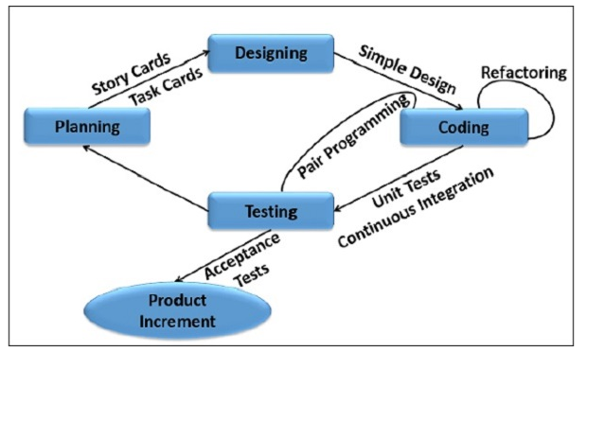
Extreme Programming (XP)

Slide 19
Process of XP
Planning: The first stage of Extreme Programming is planning. During this phase, clients define their needs in descriptions known as user stories. The team calculates the effort required for each story and schedules releases according to priority and effort.
Designing: For effective software engineering, coding and testing alone are not enough. It is imperative to plan ahead and design an efficient system with simplicity at its core.
Coding: One of the main activities in software engineering. Coding involves writing the actual code for a program or application following good coding practices.
Testing: After completing a program component, it is important to test it individually as well as in coherence with the entire system (unit testing). After successful technical testing, acceptance testing must be carried out, which ensures that the end result is in line with the customer’s expectations and needs.
Listening: Listening for feedback during the development process is a fundamental element of XP. User’s changing requirements must be expected, heard, and integrated into the existing system smoothly and quickly.

Slide 20
XP Values
Communication: Knowledge is universally shared among the team through verbal communication, shared development, feedback, and so on. This allows the entire team to be on the same page as they have a comprehensive view of the entire project.
Simplicity: Developers try to maintain simplicity in both the quality of the code as well as the features they implement. This is done to ensure that maximum output while saving time and effort instead of working on things that are too far ahead.
Feedback: XP follows the rapid feedback principle, where feedback, when done frequently , is considered to be of paramount importance. By conducting frequent unit testing, appropriate feedback can be received, which then guides the project on the best trajectory.
Respect: A project consists of individuals, and each individual has a common goal at heart. Therefore, every contribution by everyone is to be considered of value.
Courage: Many aspects of the project involve courage, whether it is to stay persistent when faced with a difficult problem or to be able to change or remove code following a change in user requirements.

Slide 21
Adaptive Software Development (ASD)
Adaptive Software Development is a method to build complex software and systems. ASD focuses on human collaboration and self-organization. Adaptive software development (ASD) is a software development process that grew out of the work by Jim Highsmith and Sam Bayer on rapid application development (RAD).
It is a Software Development Methodology that emphasizes adaptability to respond to changing requirements and environments. It focuses on continuous learning and is considered a part of agile software development.
Iterative Development: ASD breaks down the project into small, manageable iterations, delivering incremental values.
Risk Management: ASD involves identifying and addressing risks early in the development process.
Continuous Testing: It integrates testing throughout the development process to ensure high-quality outcomes.
Decentralized Control: It encourages decision-making at the team level instead of relying on top-down directives.
Customer Satisfaction: It prioritizes customer satisfaction by delivering products that meet their needs and expectations.

Slide 22
Characteristics of ASD Process
Adaptability: ASD focuses on high-level adaptive planning instead of detailed, fixed plans.
Collaborative Environment: In ASD, a strong focus is on collaboration within the team, thus promoting a culture of open communication.
Continuous Learning: It emphasizes learning from each iteration and using feedback to improve the process and the product.
Iterative Development: In ASD, the development is broken into small, manageable increments. Each increment delivers a piece of functional software.
Responsive to Change: It allows the project to quickly adapt to the changes in requirements, technology, and market conditions.
Risk Management: Proactive identification and management of the risks with the flexibility to adapt as risks evolve.
Emphasizes Quality: Testing is integrated throughout the development process to ensure high quality and early detection of issues. Regularly improve the code to maintain quality and adaptability.
Empowerment and Ownership: It allows teams to make decisions and take ownership of their work. It also encourages decision-making at the team level to promote responsiveness and accountability.

Slide 23
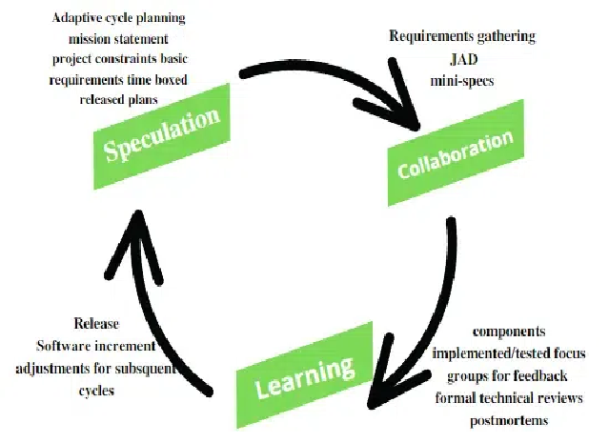
Phases of ASD Process

Slide 24
Phases of ASD Process
ASD life cycle incorporates three phases namely:
Speculation
Collaboration
Learning
1.Speculation :-
During this phase project is initiated and planning is conducted. The project plan uses project initiation information like project requirements, user needs, customer mission statement, etc, to define a set of release cycles that the project wants.

Slide 25
Phases of ASD Process
2. Collaboration :-
It is the difficult part of ASD as it needs the workers to be motivated. It collaborates communication and teamwork but emphasizes individualism as individual creativity plays a major role in creative thinking. People working together must trust each other to
Criticize without animosity,
Assist without resentment,
Work as hard as possible,
Possession of skill set,
Communicate problems to find effective solutions.

Slide 26
Phases of ASD Process
3.Learning
The workers may have an overestimate of their understanding of the technology which may not lead to the desired result. Learning helps the workers to increase their level of understanding of the project.
The learning process is in 3 ways:
Focus groups
Technical reviews
Project postmortem

Slide 27
Advantages of ASD
Customer Focus: Regular and active involvement of customers to make sure that the product meets their needs and expectations.
Continuous Delivery: Delivering functional software in small, manageable increments allows for early and continuous delivery of value.
Early Problem Detection: Regular testing and releases help to identify and resolve issues early in the development process.
Strong Teamwork: Emphasizes teamwork among the team members, thus fostering a supportive environment.
Continuous Learning: Continuous learning from each iteration helps to improve processes and products.
Empowered Teams: In ASD, teams are given the autonomy to make decisions, leading to higher motivation.

Slide 28
Disadvantages of ASD
Requires High Level of Skill: Successful implementation of ASD requires a team with a high-level of skill, experience, and familiarity with the agile principles.
Changing Requirements: The flexible nature of ASD may result in frequent changes of requirements, which might result in scope creep if it is not managed properly.
Customer Availability: ASD relies heavily on active and continuous customer participation, which can be difficult to achieve in cases when the customer is not fully engaged or not available.
Uncertain Project Outcomes: The iterative and adaptive nature of ASD makes it difficult to predict the outcome of the project.
Cultural Shift: Organizations may face resistance to the cultural shift needed to fully utilize the principles of ASD.
Requires Specific Tools: ASD may require specific tools and infrastructure for version control and automated testing, which might not be available in all organizations.
Iteration Overhead: Managing frequent iterations can introduce overhead, which may hamper productivity if not managed effectively.

Slide 29
Scrum
Scrum is a management framework that teams use to self-organize tasks and work towards a common goal.
It is a framework within which people can address complex adaptive problems while the productivity and creativity of delivering products are at the highest possible value.
Scrum allows us to develop products of the highest value while making sure that we maintain creativity and productivity.
The iterative and incremental approach used in scrum allows the teams to adapt to the changing requirements.

Slide 30
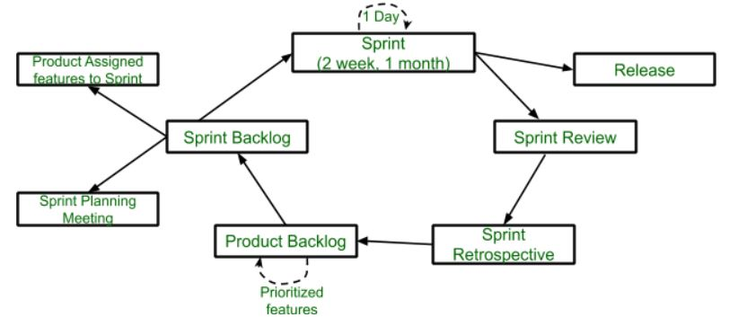
Scrum

Slide 31
Scrum
Sprint: A Sprint is a time box of one month or less. A new Sprint starts immediately after the completion of the previous Sprint.
Release: When the product is completed, it goes to the Release stage.
Sprint Review: If the product still has some non-achievable features, it will be checked in this stage and then passed to the Sprint Retrospective stage.
Sprint Retrospective: In this stage quality or status of the product is checked.
Product Backlog: According to the prioritize features the product is organized.
Sprint Backlog: Sprint Backlog is divided into two parts Product assigned features to sprint and Sprint planning meeting.

Slide 32
Advantage of Scrum
Scrum framework is fast moving and money efficient.
Scrum framework works by dividing the large product into small sub-products. It's like a divide and conquer strategy
In Scrum customer satisfaction is very important.
Scrum is adaptive in nature because it have short sprint.
As Scrum framework rely on constant feedback therefore the quality of product increases in less amount of time

Slide 33
Disadvantage of Scrum
Scrum framework do not allow changes into their sprint.
Scrum framework is not fully described model. If you wanna adopt it you need to fill in the framework with your own details like Extreme Programming(XP),Kanban, Dynamic Systems Development Method(DSDM).
It can be difficult for the Scrum to plan, structure and organize a project that lacks a clear definition.
The daily Scrum meetings and frequent reviews require substantial resources.

Slide 34
Dynamic System Development Model (DSDM)
DSDM is an iterative Agile product development framework.
It aims to work efficiently, delineate stages of the development life cycle and provide tangible benefits to all parties involved with a project.
This method works throughout the entire project life cycle, offering guidance about the best practices for delivering products on time and within budget.
It also seeks to demonstrate scalability and to address the needs of all project sizes and for any industry or business sector.

Slide 35
Principles of DSDM
Focus on the business need. DSDM teams work towards achieving projects that align with greater business objectives and exist within parameters that make sense for the business.
Deliver on time. Prompt delivery is a vital part of DSDM projects, as one of the method's goals is to reap benefits early.
Collaborate. It's crucial that DSDM teams involve all relevant parties and grant each other the means to give feedback and make decisions.
Maintain high quality. DSDM teams set clear standards before beginning work and evaluate their progress regularly to ensure they're meeting these standards.

Slide 36
Principles of DSDM
Build incrementally from firm foundations. Teams strive to produce the right amount of work at the right time to ensure they produce work that aligns with their plans.
Develop iteratively. Teams implement feedback promptly and adapt to ongoing changes in a project's specifications and needs.
Communicate continuously and clearly. DSDM teams can use a variety of tools to provide written, verbal and visual updates to teammates, other departments, managers and interested parties.
Demonstrate control. A team leader or project manager practices transparency to make all team members aware of changes, plans, progress, updates and goals.

Slide 37
Advantages of DSDM
Improves collaboration: DSDM can help to enhance communication efforts across various cross-functional teams and departments. This helps to minimize confusion since everyone remains updated on the latest developments that occur within the project.
Supports rapid deliverables: DSDM allows product teams to release their deliverables rapidly, minimizing delays and attending to a reasonable timeline. This helps teams increase efficiency, meet client needs and achieve a launch sooner.
Promotes feedback: The approach encourages teams to stay in close communication with interested parties to receive frequent feedback and suggestions. When a team can gather critical evaluations regularly, they may be able to adjust accordingly.

Slide 38
Advantages of DSDM
Enhances project organization: When a development team implements the DSDM method, there are a variety of tools and strategies they can use to help better manage the overall operation. Having more control over how the development process expands is essential for remaining organized and on schedule.
Sets clear guidelines: DSDM can help teams manage their efforts to ensure they meet deadlines and stay within the budget. This can promote organizational alignment, as teams meet the expectations set by management.

Slide 39
Disadvantages of DSDM
Requires resources: DSDM can be costly to implement. Although it requires an investment to implement, it may also save an organization money by encouraging teams to work efficiently and reducing time-to-market for products.
Minimizes creativity: Because it encourages developers to work quickly, it may limit risk-taking. The focus on iterative development may allow professionals to revisit their work to infuse more unique, creative elements later.
Demands structure: DSDM works best when teams have a reliable structure, full support from management and capable project managers to lead the project life cycle. You can implement more structure in your team before committing to DSDM to ensure its success.

Slide 40
Agile Unified Process (AUP)
Agile Unified Process (AUP) is a lightweight, iterative, and adaptable software development methodology that combines the best practices of agile development with the disciplined approach of the Unified Process (UP).
AUP is designed to deliver high-quality software that meets the changing needs of the stakeholders in an efficient and effective manner.
In this article, we will explore the key principles, phases, and practices of AUP, and highlight its benefits and limitations.

Slide 41
Phases of Agile Unified Process
Inception Phase: The Inception phase is the initial phase of the project, where the scope, objectives, and requirements of the project are defined. The key deliverables of this phase include the Project Vision, Business Case, Use-Case Model, and Risk List.
Elaboration Phase: The Elaboration phase is the most critical phase of the project, where the requirements are analyzed, designed, and validated. The key deliverables of this phase include the System Architecture, Software Requirements Specification, Software Architecture Document, and Test Plan.
Construction Phase: The Construction phase is the phase where the actual coding, testing, and integration of the software take place. The key deliverables of this phase include the Source Code, Unit Test Cases, and User Documentation.
Transition Phase: The Transition phase is the final phase of the project, where the software is deployed and delivered to the stakeholders. The key deliverables of this phase include the User Acceptance Test Report, Deployment Plan, and User Manual.

